Slide 1
Unit 3
Sexual and Reproductive Health

Slide 2
Concept of Sexuality
Sexuality is a basic human need and an innate part of the total personality. It influences our thoughts, actions and interactions, and is involved in aspects of physical and mental health.
Distinct components of sexuality, includes sexual identity, sexual behavior and sexual desire.
Society's attitude towards sexuality is changing. Clients are more open to seeking assistance in matters of pertaining to sexuality.
Notes:
Innate-inborn, natural

Slide 3
Concept contd…
Although not all nurses need to be educated as sex therapists, they can readily integrate information on sexuality into the care given by focusing on preventive, therapeutic, and educational interventions to assist individuals to attain, regain or maintain sexual wellness.

Slide 4
The working definition of Sexuality by WHO
“Sexuality” is:... a central aspect of being human throughout life [that] encompasses sex, gender identities and roles, sexual orientation, eroticism, pleasure, intimacy and reproduction. Sexuality is experienced and expressed in thoughts, fantasies, desires, beliefs, attitudes, values, behaviors, practices, roles and relationships. While sexuality can include all of these dimensions, not all of them are always experienced or expressed. Sexuality is influenced by the interaction of biological, psychological, social, economic, political, cultural, legal, historical, religious and spiritual factors.”

Slide 5
Definition
SEXUAL HEALTH:It is the integration of the somatic, emotional, intellectual and social aspects of sexual being, in ways that are positively enriching and enhance personality, communication and love.
"Sexual health is a state of physical, emotional, mental and social well-being in relation to sexuality; it is not merely the absence of disease, dysfunction or infirmity.” -WHO-1950

Slide 6
FACTORS INFLUENCING SEXUALITY
Many factors influence a person's sexuality such as developmental level mentioned below:
a)Culture
b) Religious Values
c) Personal
d) Health Status
e) Medication

Slide 7
Basic concept of gender
Gender Vs. Sex
Sex identifies biological differences between men and women. E.g. Women can give birth and men provide sperm. Sex is universal (every nation, throughout history)
Gender identifies social relations between men and women. Gender is socially constructed. But gender roles are dynamic and change over time.

Slide 8
Cont….
Gender Refers to the socially constructed roles and status of women and men, girls and boys. It is a set of culturally specific characteristics defining the social behaviour of women and men, boys and girls, and the relationships between them.
Gender roles, status and relations vary according to place (countries, regions, and villages), groups (class, ethnic, religious, caste), generations and stages of the lifecycle of individuals.
Gender is, thus, not about women but about the relationship between women and men.

Slide 9
Gender equity
Means fairness of treatment for women and men, according to their respective needs.
This may include equal treatment or treatment that is different but considered equivalent in terms of rights, benefits, obligations and opportunities.
In the development context, a gender equity goal often requires built-in measures to compensate for the historical and social disadvantages of women.

Slide 10
Cont…..
Gender; Refers to the socially constructed roles and status of women and men, girls and boys. It is a set of culturally specific characteristics defining the social behaviour of women and men, boys and girls, and the relationships between them.
Gender roles, status and relations vary according to place (countries, regions, and villages), groups (class, ethnic, religious, caste), generations and stages of the lifecycle of individuals.
Gender is, thus, not about women but about the relationship between women and men.

Slide 11
Reproductive health
Reproductive health (RH) is a state of complete physical, mental and social well being in all matters related to the reproductive system and to its function and processes.
ICPD Programme of Action, 1994

Slide 12
Contd…
To maintain one’s sexual and reproductive health, people need access to accurate information and the safe, effective, affordable and acceptable contraception method of their choice.
They must be informed and empowered to protect themselves from sexually transmitted infections.
And when they decide to have children, women must have access to services that can help them have a fit pregnancy, safe delivery and healthy baby.
Every individual has the right to make their own choices about their sexual and reproductive health.

Slide 13
Cont…..
Reproductive health therefore implies that people are able to have a satisfying and safe sex life and that they have the capability to reproduce and the freedom to decide if, when, and how often to do so.
It is recognized that RH is a crucial part of overall health and is central to human development which affects every individual.

Slide 14
Contd…
In addition to these, it also includes gender equity and equality, empowerment of women and the provision of universal access to appropriate health services over the life cycle.
Not only is it a reflection of health in infancy, childhood and adolescence, it also sets the stage for health beyond the Reproductive years for both women and men and has pronounced effects from one generation to another.

Slide 15
Reproductive Health Rights
The right to decide whether to marry, and to decide if, when and how many children to have.
The right to well being through life, for all matters relating to the reproductive system.
The right to a responsible, healthy, safe and satisfying sex life.
The right to unrestricted access to information in order to make informed choices.
The right to have available safe, effective, affordable and acceptable family planning methods of choice.

Slide 16
Contd…
The right to safe pregnancy and birth.
The right to be free from sexual violence and assault.
The right to privacy in relation to reproductive health.
The right of access to appropriate health care services that will enable them to go safely through pregnancy and childbirth, thus providing couples with the best chance of having a healthy infant.

Slide 17
Importance of Reproductive Health
the right to health in general
the right to reproductive choice
the right to receive reproductive health services
the right of men and women to marry and found a family
the right of individuals to make reproductive decisions free of discrimination, coercion and violence
the right of the family to special protection
and sometimes, concepts of special rights in relation to motherhood and childhood (pre- and post-natal care)

Slide 18
Contd…
Other essential human rights are those that permit women to realize their dignity economically, socially, and culturally.
The ICPD Programme of Action states…. "The empowerment and autonomy of women is a highly important end in itself. In addition, it is essential for the achievement of sustainable development.
Evidence shows that population and development programes are most effective when steps are taken to improve the status of women, including their access to secure livelihoods and economic resources, and full participation in public life.”

Slide 19
COMPONENTS
Safe motherhood
Family planning.
Child health
Prevention and management of complications of abortion
RTI/STI/HIV/AIDS
Prevention and management of sub fertility
Adolescent reproductive health
Problems of elderly women
Gender based violence

Slide 20
Scope of Reproductive Health
The RH within the context of primary health care includes following essential components:
Family planning counseling, information, education, communication and services (emphasizing the prevention of unwanted pregnancy).
Safe motherhood; education, and service for healthy pregnancy, safe delivery and postnatal care including breast feeding.
Care of new born
Prevention and management of complications of abortion

Slide 21
Cont…….
Prevention and management of RTIs, STDs, HIV/AIDS and other RH conditions.
Information, education, and counseling, as appropriate, on human sexuality, reproductive health and responsible parenthood for individuals, couples, and adolescent.
Prevention and management of sub fertility
Life-cycle issues including breast cancer, cancer of the reproductive system and care of the elderly

Slide 22
Evolution of the concept
The original model of RH in 1970 focused mainly on fertility control.
A new paradigm of RH has been emerged at the International Conference of Population and Development (ICPD) in 1994 –focused on human right.
This model encompasses broader concept of RH that has considered basic human rights, Human development and individual wellbeing at all stages of life.

Slide 23
Cont….
Some important human rights related to reproductive health are as follows;
Right to lead a responsible and satisfied sex life.
Right to reproduce and freedom to decide when and how often to do so.
Right to be informed about advantages, possible risks and side effects of contraceptives.
Right to have free, equal access to safe, effective, affordable, and acceptable method of fertility regulation.
Right to get access to appropriate health service of good quality to go through safe pregnancy and child birth.
The new concept of RH was endorsed in 1995 by Fourth World Conference on Women in Beijing.

Slide 24
EVOLUTION OF REPRODUCTIVEHEALTH SERVICE IN NEPAL
Family planning (private sector in 1958, public policy in 1965.
Family planning and MCH program in 1968
STD and AIDS control programme in 1988.
Safe motherhood policy in 1994.
National safe Motherhood Plan (2002-2017)

Slide 25
Approaches to address the RH problems
RH is not a new programme, but rather a new approach which seeks to strengthen the existing safe motherhood, family planning, HIV/AIDS, STD, Child survival and nutrition programmes with a holistic life cycle approach.
This calls for strengthening interdivisional linkages within the department of health services as well as between other sectors e.g. Education, and women and development, local development at the legal system

Slide 26
Guiding principle of Reproductive health developed by ICPD:
Empowerment of women
Involve women, women’s organization
Promote men’s participation in RH/FP
Assure highest level of quality of care
Integrated services
Make available effective methods of FP.

Slide 27
NATIONAL REPRODUCTIVE HEALTH STRATEGY
Implement the Integrated Reproductive Health Package at all levels based on standardized clinical protocols and operational guidelines.
Enhance functional integration of RH activities carried out by different divisions.
Emphasize advocacy for the concept of RH including inter and intra-sectoral collaboration.
Review and develop IEC materials
Review and update the existing training curricula of various health workers.
Ensure effective management system by strengthening and revitalizing existing committees at various levels.

Slide 28
CONTD………
Develop national RH research strategies which outlines research priorities and work plans based on information requirements of policy makers, planners, managers, and service providers
Construct /upgrade appropriate service delivery and training facilities at the National, regional, District and health post level.
Institutional strengthening through structural planning, monitoring/ Supervision and performance evaluation review.
Develop an appropriate RH programme for adolescents
Support for national experts/consultants
Promote inter-sectoral and multi-sectoral co- ordination.

Slide 29
INTEGRETED HEALTH PACKAGE
Based on the essential element of Comprehensive Reproductive health Care, an integrated health care package has been adopted for Nepal. The integrated Reproductive health care package will include;
Family planning
Safe motherhood
Child health (new born care)
Prevention and, management of complications of abortion
RTI/STD/HIV/AIDS
Prevention and management of sub fertility
Adolescent reproductive health
Problem of elderly women, i.e. uterine prolapsed, cervical and breast cancers treatment at tertiary and private sectors.

Slide 30
LEVEL OF INTERVENTION
Family / Decision makers’ level
Community level
Sub-health post /Health post level
Primary health care center level

Slide 31
Major problems related to RH
1.Maternal morbidities:
a. Immediate complications: Sepsis, hypertensive disorders, hemorrhage etc.
b. Long term complications: Vesicovaginal or rectovaginal fistula, uterine prolapse, Pelvic inflammatory diseases, urinary or faecal

Slide 32
Contd.
c. Indirect obstetric morbidity: Resulted from diseases like anaemia, TB, aggravated by the physiological effects of pregnancy.
d. Psychological obstetric morbidity: Postpartum psychosis or depression and other mental health problems

Slide 33
2. Gynecological morbidity:
Condition, disease or dysfunction of reproductive system that is not related to pregnancy, abortion or childbirth, but may be related to sexual behavior.
a. Reproductive tract infection
i) STIs: Viral, bacterial, chlamydial infections, gonorrhoea, trichomoniasis, syphilis, chancroid, genital herpes, genital warts and HIV.
ii) Endogenous infections: overgrowth of organisms normally present in the vagina e.g. bacterial vaginosis and candidiasis.

Slide 34
Contd……..
iii) Iatrogenic infections: introduction of microorganism into the reproductive tract through a medical procedure.
b. Endocrine or hormonal disorder: Metrorrhagia, amenorrhea, menorrhagia, dysmenorrhoea, oligomenorrhoea
c. Infertility: WHO estimates 8-12% of couples are infertile. causes: endocrinal disorder, STI, puerperal sepsis, post abortion sepsis, congenital

Slide 35
Contd…….
d. Uterine prolapse
Causes:
-Multiparity,
-Excess intra abdominal pressure
Tissue atrophy
Chronic health problem: constipation, pulmonary disease etc.
Family history
Hard physical labour, lifting heavy weights
Poor nutrition

Slide 36
Contd.
e. Gynaecological cancers:
Cervical cancer, Breast cancer, Endometrial cancer, Ovarian cancer, Vaginal caner, Vulva cancer, Rarely fallopian tubes.
f. Sexual dysfunction
g. Menopausal problems

Slide 37
FAMILY / DECISION MAKERS LEVEL 1
1. Family planning
Need identification
Knowledge of shops and institutions where contraceptives are available

Slide 38
2. Safe Motherhood
Identification of pregnant woman and recognition of danger signs
Provide nutritious diet, supplements and adequate rest to pregnant women.
Encourage utilization of antenatal care services.
Identify SBA for care during delivery.
Birth preparedness and complication readiness including arrangement of emergency funds and transport.
Encourage utilization of postnatal care.
Encourage registration of maternal death

Slide 39
3.New born care
Proper care of newborn baby
Identification of danger signs and complications related to newborn and seek care from appropriate health institution.
Complete immunization as the schedule of EPI programme.
Registration of neonatal birth and death event.

Slide 40
Cont….
4. Prevention and management of abortion complication: Recognition of sign and symptoms of abortion complications. , Know where to seek help.
5. RTI/STI/HIV/AIDS: Promotion of condom., Recognize RTI/STD symptoms and seek care.,Treatment of both partners in the case of infection.
6. Infertility: Identification of Infertility, Seek care and treatment of infertility by both partners.

Slide 41
Cont….
7. Adolescent health:
Family life education programme; eg, discussion between parents and children about; delay marriage, delay pregnancy, nutritious diet especially to daughter and education to daughters etc.
8. Elderly RH problem; Identification of RH problem of reproductive organs, Identification of different health institutions for their treatment and management.

Slide 42
RH SERVICE AT COMMUNITY LEVEL
1.Family planning
Sexuality and gender information, education, and counseling for adolescents, youth, men, and women.
Community based contraceptives distribution through community based health workers / volunteers, women’s groups, community based workers.
Social marketing of condoms and re-supply of oral pills through community service.
Counseling and referral for other contraceptive methods.
IEC for LAM

Slide 43
2. Safe Motherhood
Counseling /education for breast feeding, nutrition, FP, rest exercise etc.
Awareness rising for risk factors.
Recognizing dangers signs Support SBA
Create awareness about services that SBA offers.
Mobilize community to support referral and transportation ( emergency fund and transport)
Identification of local health institution of maternal and neonatal health MNH) services.

Slide 44
Cont….
Help the poor and underprivileged to utilize MNH services.
IEC /counseling for danger signs during pregnancy, delivery, postpartum for mother.
Identify potential blood donors for emergency.
Encourage utilization of antenatal care services.
Birth preparedness and complication readiness with families (delivery by SBA and preparation or arrangement of emergency funds and transport).
Detection of complication complications in mother and baby and facilitation for referral to health facility.
Postnatal visit for mother and baby.
Encourage for registration of maternal death.

Slide 45
3.New born care
Counseling /education for breast feeding, baby care prevention from hypothermia, immunization.
Early and exclusive breast feeding promotion and counseling.
Identification of danger sign related to newborn baby refer to nearest appropriate health facility.
Promotion and management of neonatal hypothermia by keeping baby warm and immediate breast feeding.
Encourage to complete immunization for newborn as the schedule of EPI programme.
Encourage for registration of neonatal birth and death event.

Slide 46
4. Prevention and management of abortion complication
Counseling on prevention of unwanted pregnancy, or FP counseling, and re-supply of oral pills and condom.
Recognition of danger signs for spontaneous and induced abortion with referral to nearest appropriate health facility for diagnosis and treatment.
Recognition of sign and symptoms of abortion and its complications.
Timely referral to the appropriate formal health care system.
Counseling on unwanted pregnancy and safe abortion service

Slide 47
5. RTI/STI/HIV/AIDS
Sexuality and gender education and counseling.
Condom Promotion and distribution.
Counseling on safe sexual activity.
Counseling / education on RTI/ STD / HIV infection management and treatment.

Slide 48
6. Infertility
Prevention and treatment of infertility by counseling and education.
Refer to appropriate health facility for treatment and management of infertility to both partners.
counseling and education for prevention and treatment of infertility
Refer to appropriate health facility for treatment and management of infertility to both partners.

Slide 49
7. Adolescent health
Information on sexuality and gender information.
Create awareness on risk factors of early marriage and pregnancy.
Conduct the programme of Family life education.
Increasing awareness on FP method availability of contraceptives, danger signs and risk factors of teenage pregnancy.
Adolescent health

Slide 50
8.Elderly RH problem
Health promotion information (including information on uterus prolapse and smoking prevention).
Identification of RH problem related to reproductive organs.
Identification of different health institutions for their treatment and management and referral.

Slide 51
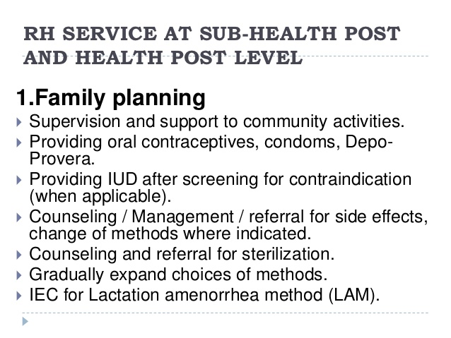

Slide 52
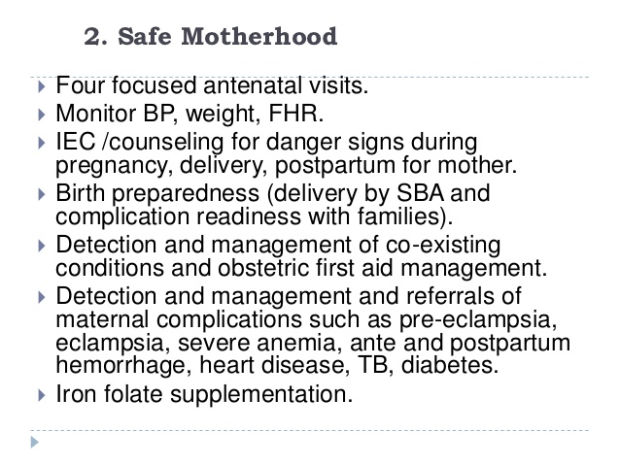

Slide 53
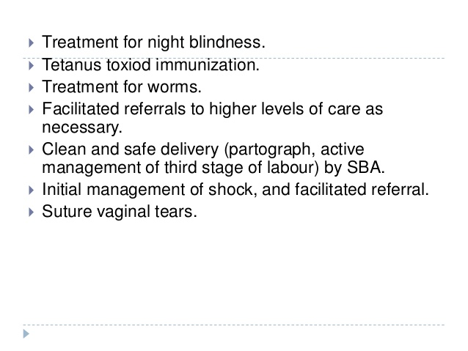

Slide 54
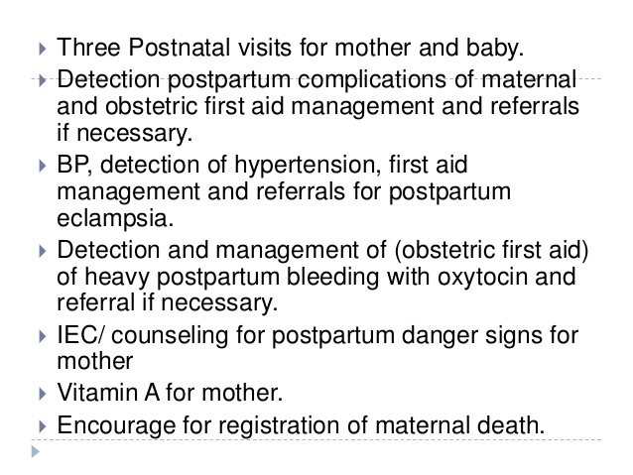

Slide 55
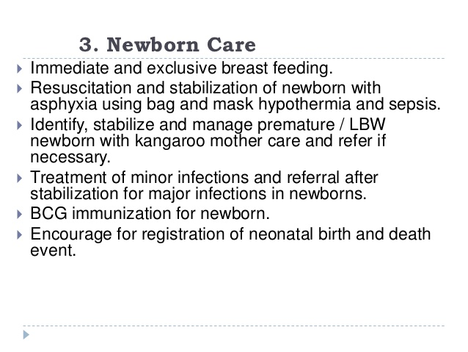

Slide 56
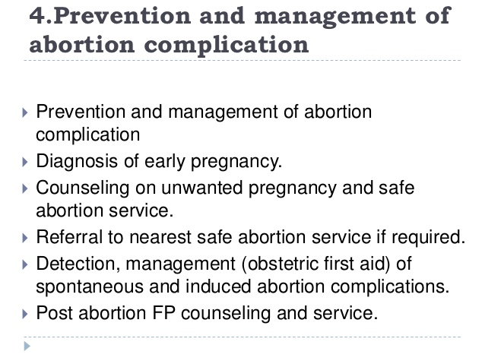

Slide 57
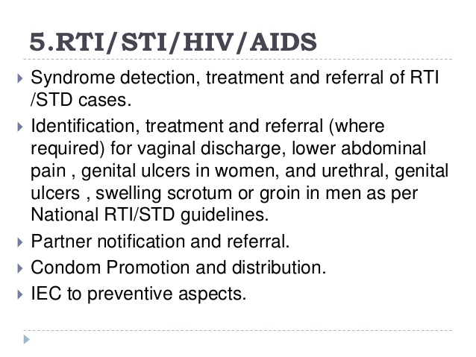

Slide 58
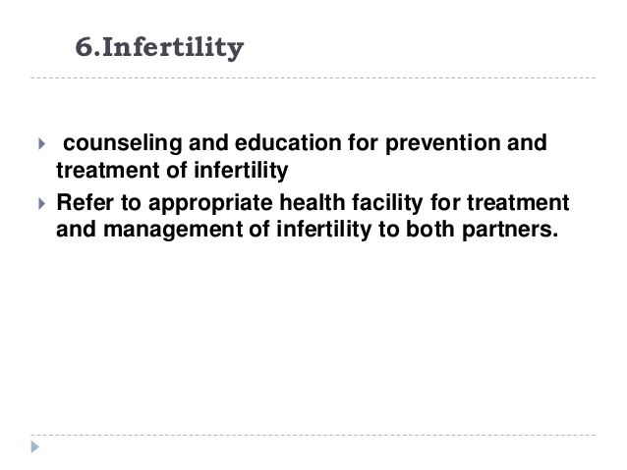

Slide 59
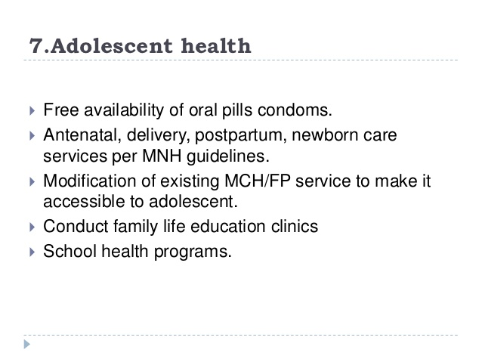

Slide 60
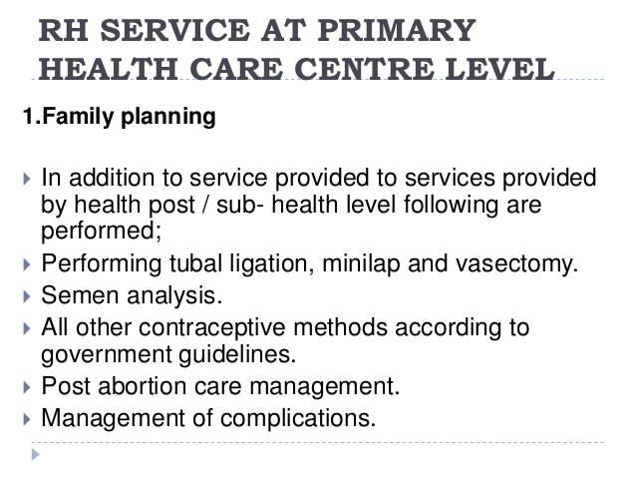

Slide 61
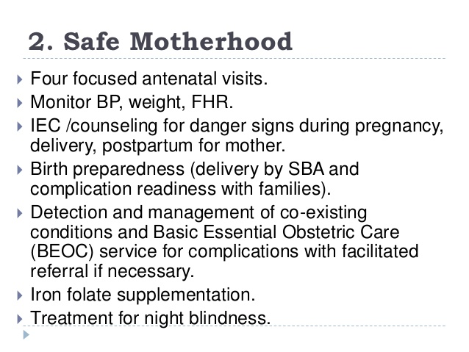

Slide 62
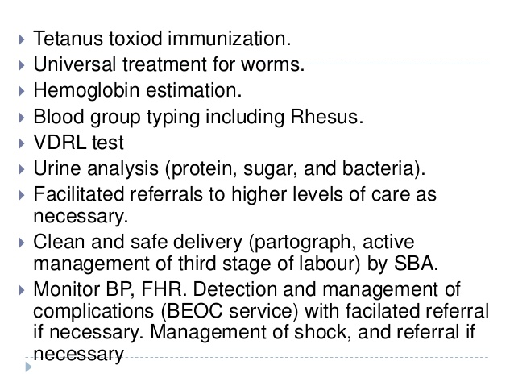

Slide 63
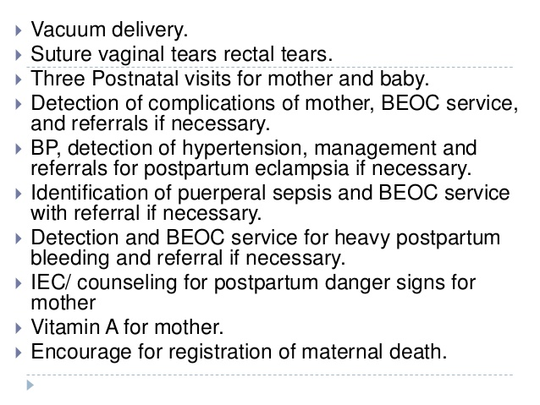

Slide 64
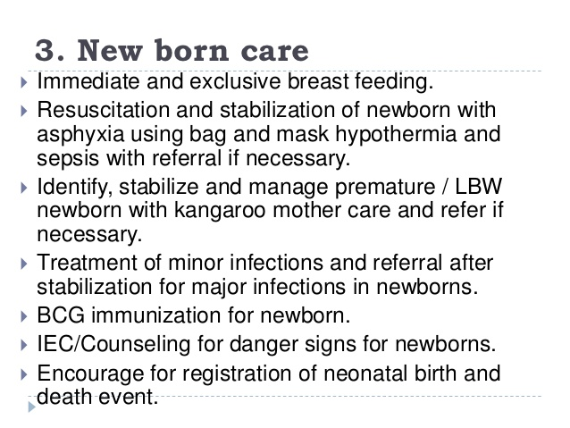

Slide 65
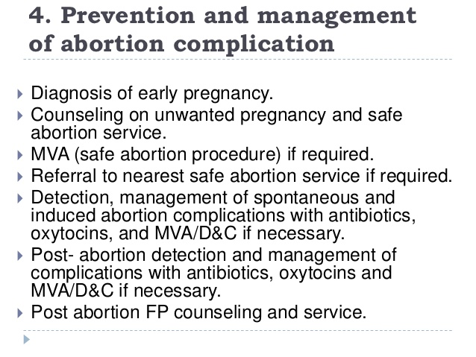

Slide 66
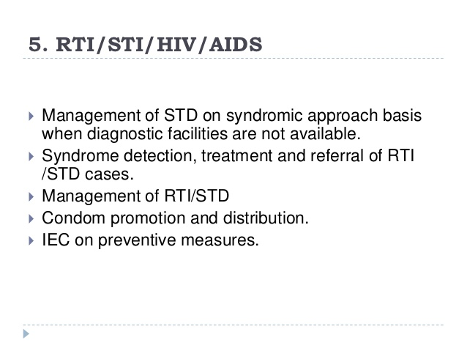

Slide 67
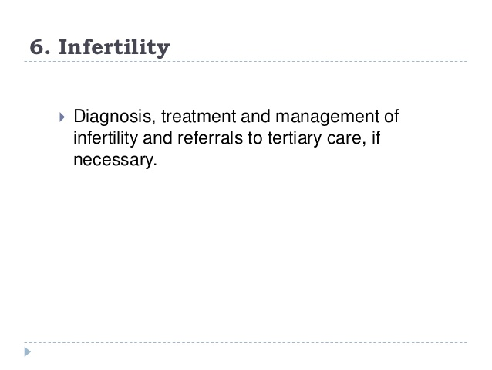

Slide 68
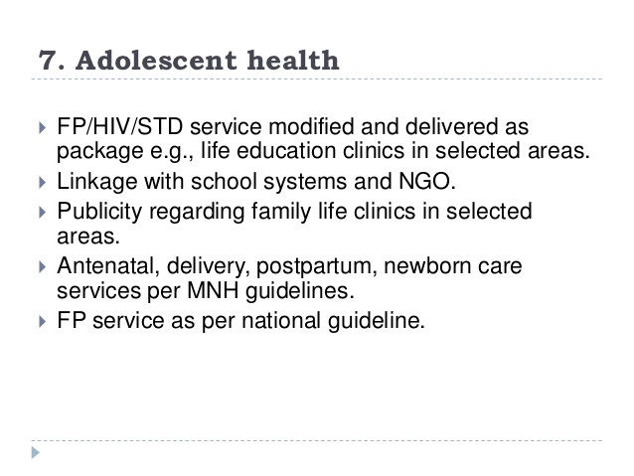

Slide 69
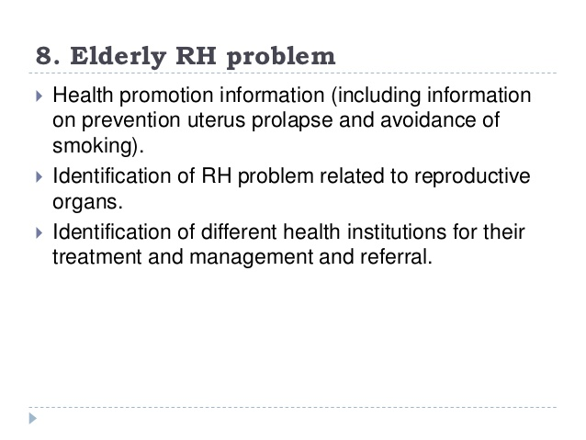

Slide 70
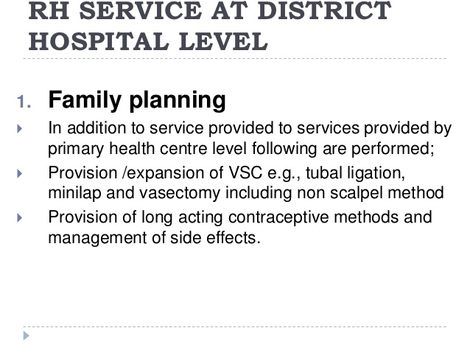

Slide 71
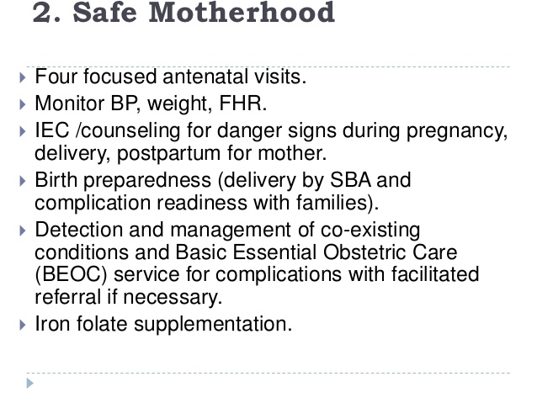

Slide 72
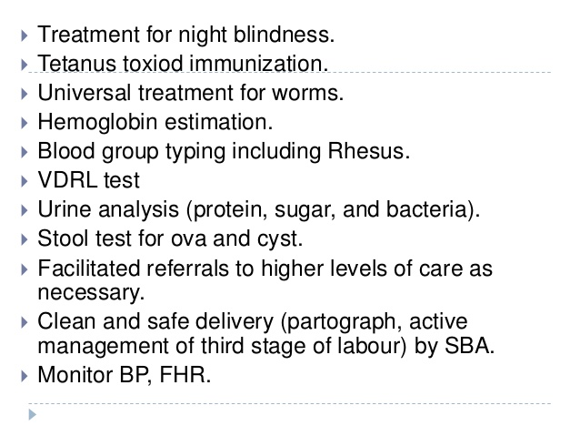

Slide 73
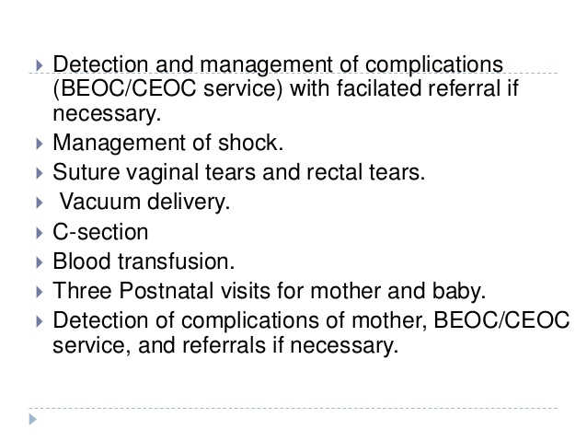

Slide 74
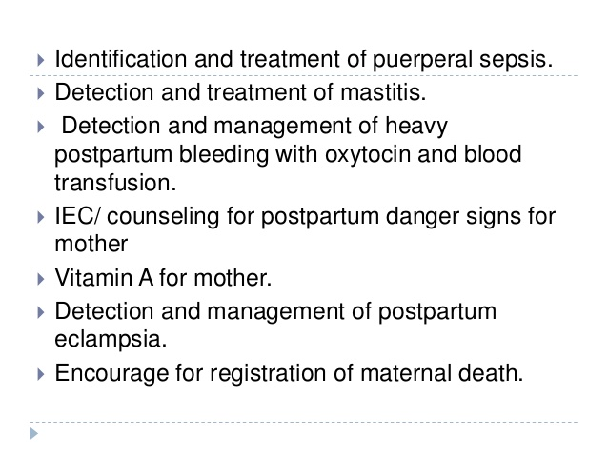

Slide 75
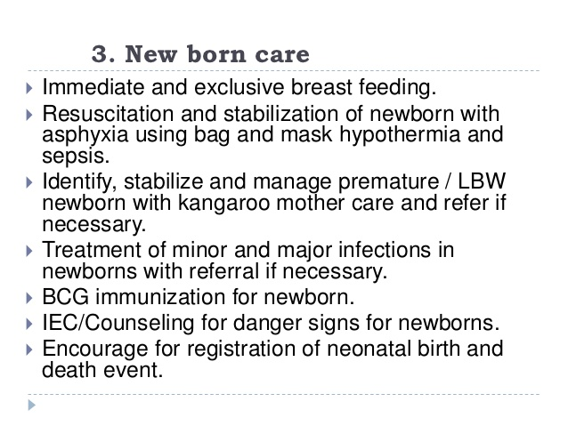

Slide 76
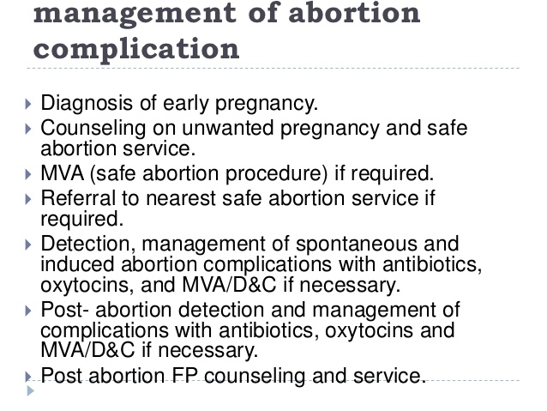

Slide 77
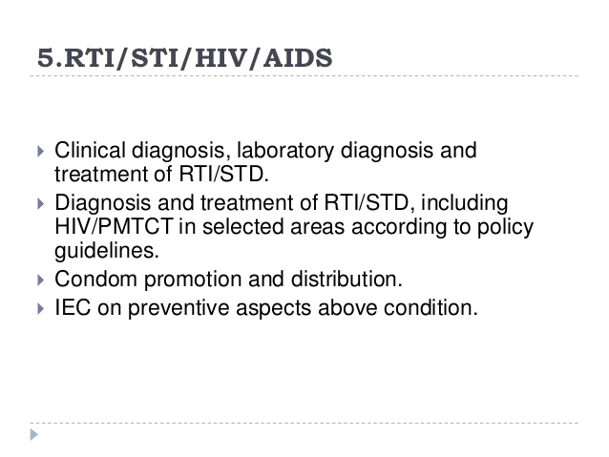

Slide 78
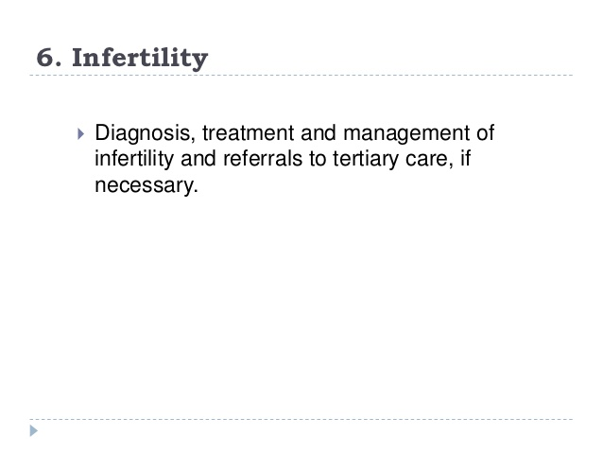

Slide 79
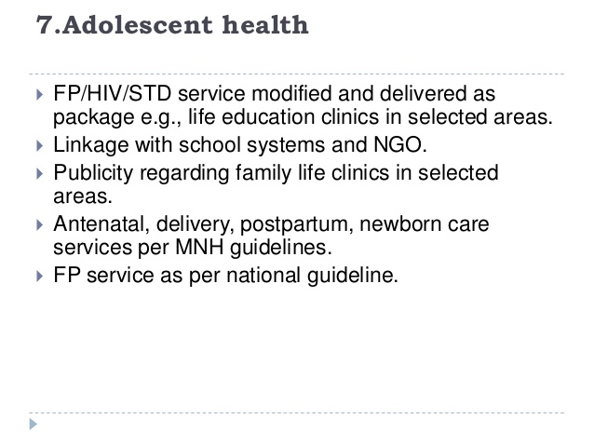

Slide 80
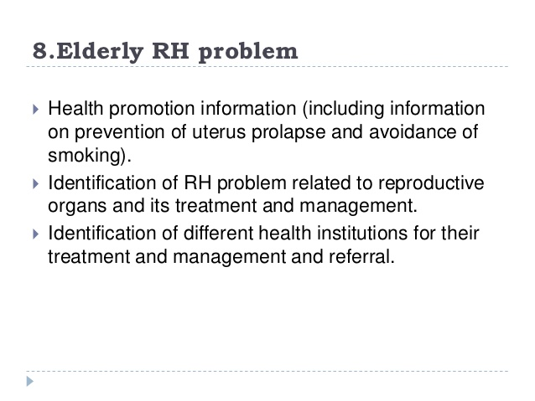

Slide 81
RH indicators
Total Fertility Rate (TFR)Total number of children a woman would have by the end of her reproductive period if she experienced the currently prevailing age-specific fertility rates throughout her childbearing life
Contraceptive Prevalence Rate (CPR)Percent of women of reproductive age (15-49) who are using (or whose partner is using) a contraceptive method at a particular point in time
Maternal Mortality Rate (MMR)Annual number of maternal deaths per 100,000 live births
Antenatal Care Coverage Percent of women attended at least once during pregnancy, by skilled health personnel (excluding trained or untrained traditional birth attendants), for reasons relating to pregnancy

Slide 82
Cont……..
Percent of Births Attended by Skilled Health Personnel Percent of births attended by skilled health personnel (excluding trained or untrained traditional birth attendants)
Availability of Basic Essential Obstetric Care Number of facilities with functioning basic essential obstetric care per 500,000 population
Availability of Comprehensive Essential Obstetric Care Number of facilities with functioning comprehensive essential obstetric care per 500,000 population
Perinatal Mortality Rate (PMR) Number of perinatal deaths per 1,000 total births

Slide 83
Cont….
Low Birth Weight Prevalence Percent of live births that weigh less than 2,500g
Positive Syphilis Serology Prevalence in Pregnant Women Percent of pregnant women (15-24) attending antenatal clinics, whose blood has been screened for syphilis, with positive serology for syphilis
Prevalence of Anemia in Women Percent of women of reproductive age (15-49) screened for hemoglobin levels with levels 110g/l for pregnant women, and 120g/l for non-pregnant women

Slide 84
Cont……
Percent of Obstetric and Gynecological Admissions Owing to Abortion Percent of all cases admitted to service delivery points providing in-patient obstetric and gynecological services, which are due to abortion (spontaneous and induced, but excluding planned termination of pregnancy)
Reported Prevalence of Women with FGC Percent of women interviewed in a community survey reporting having undergone FGC
Prevalence of Infertility in Women Percent of women of reproductive age (15-49) at risk of pregnancy (not pregnant, sexually active, non-contracepting, and non-lactating) who report trying for a pregnancy for two years or more
Notes:
FGC-female genital cutting

Slide 85
Cont…..
Reported Incidence of Urethritis in Men Percent of men aged (15-49) interviewed in a community survey reporting episodes of urethritis in the last 12 months
HIV Prevalence among Pregnant Women Percent of pregnant women (15-24) attending antenatal clinics, whose blood has been screened for HIV and who are sero-positive for HIV
Knowledge of HIV-related Prevention Practices Percent of all respondents who correctly identify all three major ways of preventing the sexual transmission of HIV and who reject three major misconceptions about HIV transmission or prevention

Slide 86
Thank You!!

